Slide 1

Computer Networks
Transport Layer Protocols
S.V.Jansi Rani
Associate Professor / CSE

Slide 2
AGENDA
Transport Layer Protocols
Simple protocol
Stop and wait protocol
Go back N protocol
Selective Repeat protocol

Slide 3



Slide 4
INTRODUCTION
The transport layer is located between the application layer and the network layer.
It provides a process-to-process communication between two application layers, one at the local host and the other at the remote host.
Communication is provided using a logical connection.

Slide 5
24-4 SCTP
Stream Control Transmission Protocol (SCTP) is a new transport-layer protocol designed to combine some features of UDP and TCP in an effort to create a protocol for multimedia communication.

Slide 6
24.4.1 SCTP Services
Before discussing the operation of SCTP, let us explain the services offered by SCTP to the application-layer processes.

Slide 7
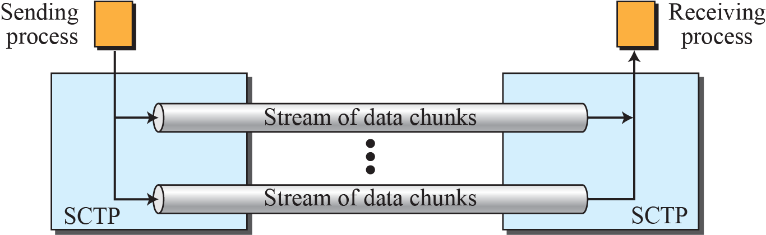
Figure 24.38 : Multiple-stream concept

Slide 8
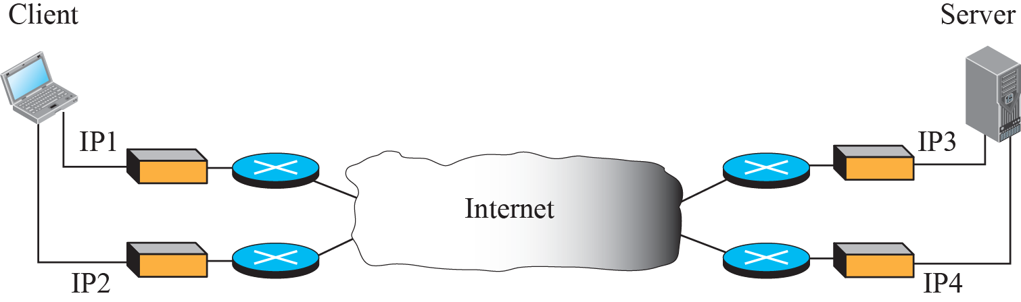
Figure 24.39 : Multihoming concept

Slide 9
24.4.2 SCTP Features
The following shows the general features of SCTP.
Transmission Sequence Number (TSN)
Stream Identifier (SI)
Stream Sequence Number (SSN)

Slide 10
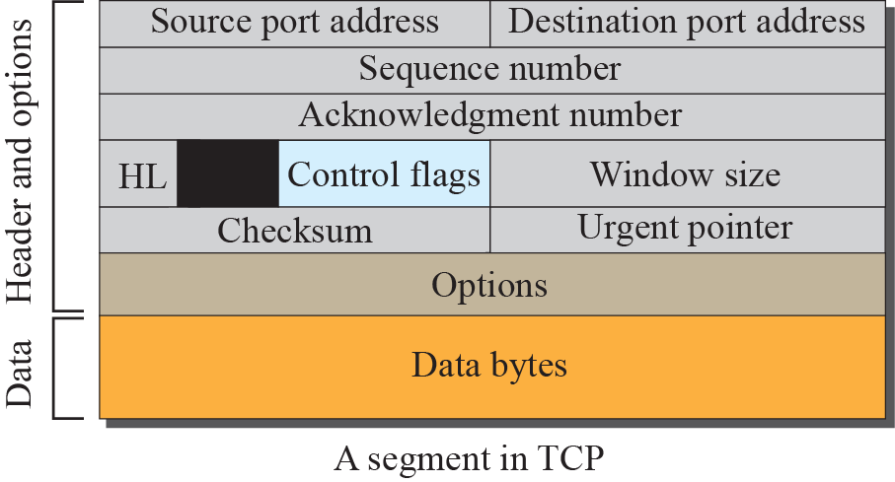
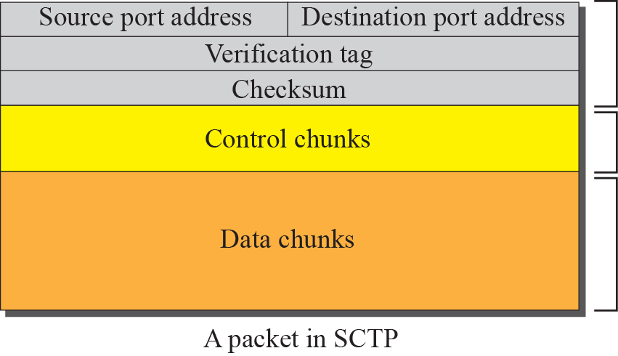
Figure 24.40 : Comparison between a TCP segment and an SCTP packet

Slide 11
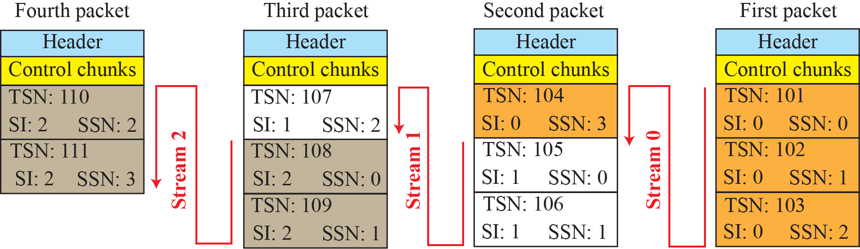
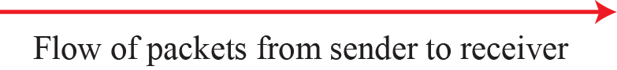
Figure 24.41 : Packets, data chunks, and streams

Slide 12
24.4.3 Packet Format
An SCTP packet has a mandatory general header and a set of blocks called chunks. There are two types of chunks: control chunks and data chunks. A control chunk controls and maintains the association; a data chunk carries user data. In a packet, the control chunks come before the data chunks. Figure 24.42 shows the general format of an SCTP packet.

Slide 13
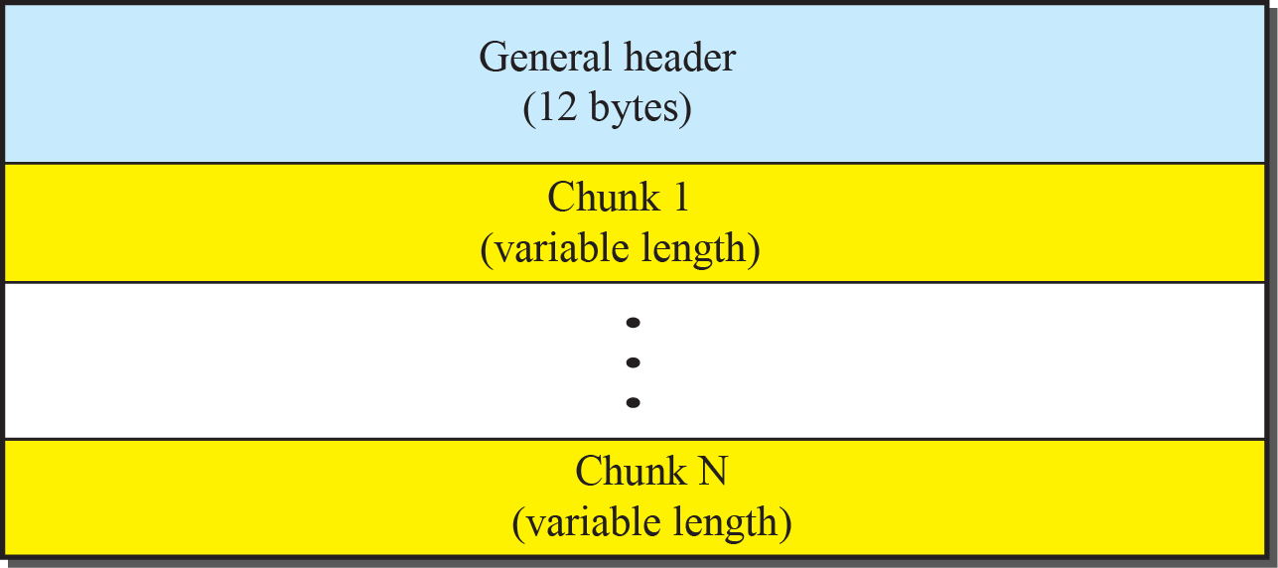
Figure 24.43 : SCTP packet format

Slide 14
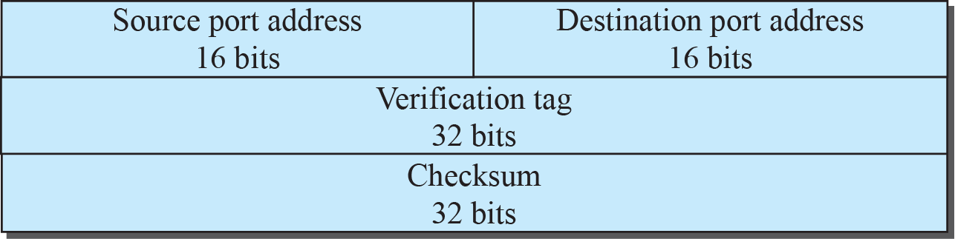
Figure 8.50 : General header

Slide 15
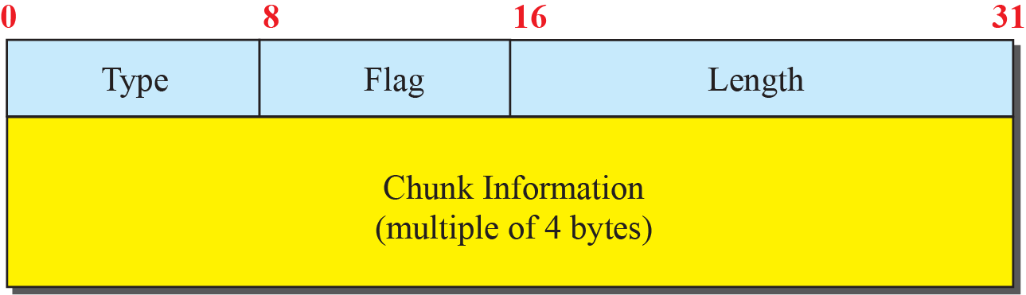
Figure 24.44 : Common layout of a chunk

Slide 16
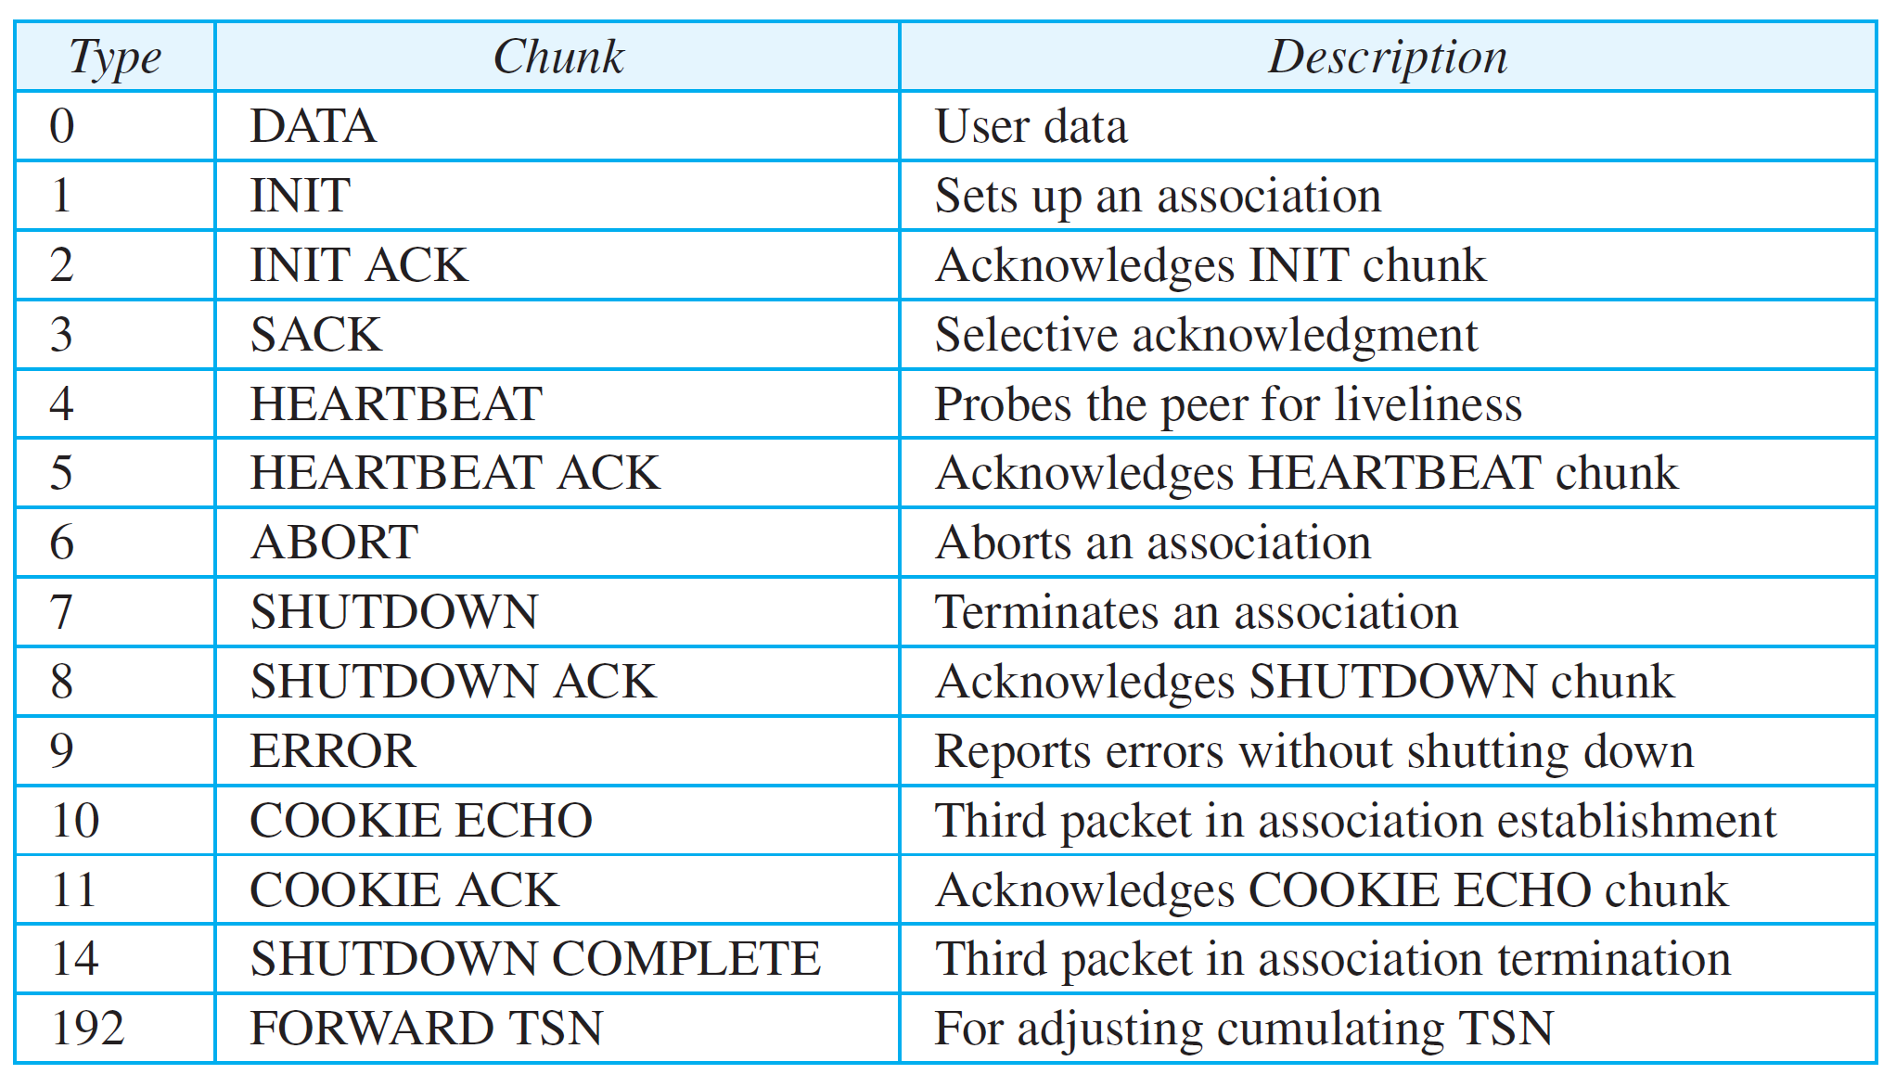
Table 24.3: Chunks
24.16

Slide 17
24.4.4 An SCTP Association
SCTP, like TCP, is a connection-oriented protocol. However, a connection in SCTP is called an association to emphasize multihoming.

Slide 18
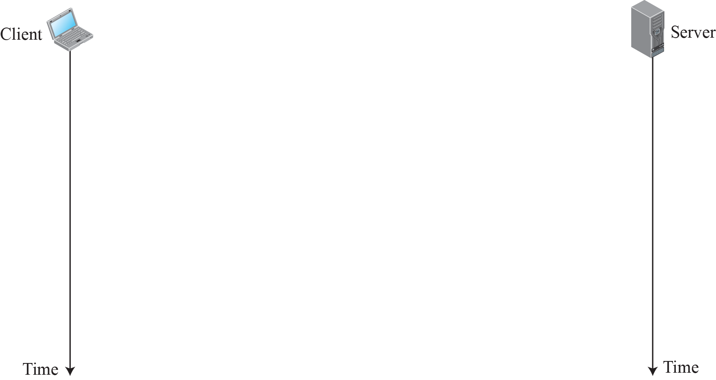
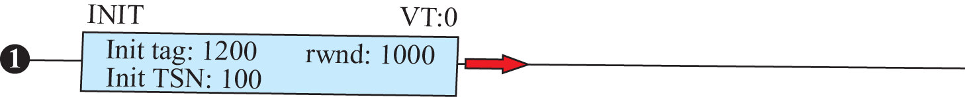
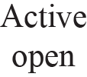
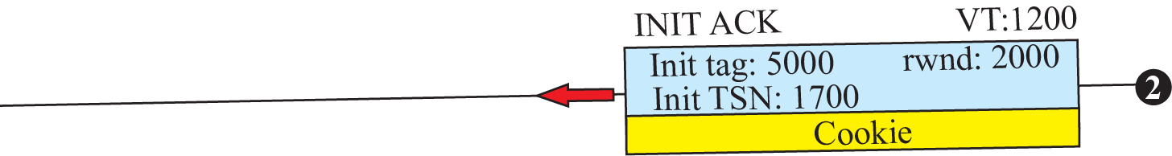
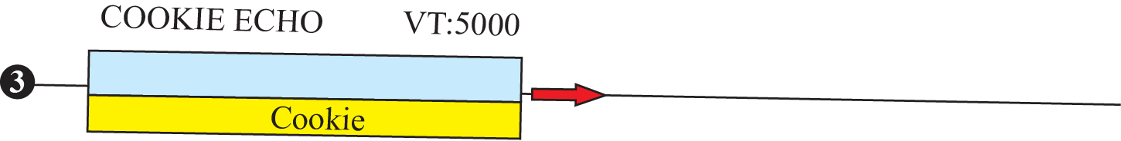
Figure 24.45: Four-way handshaking

Slide 19
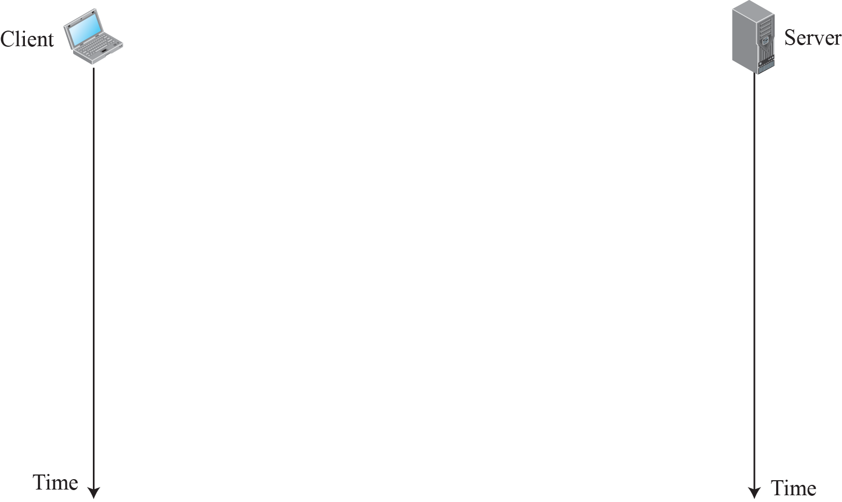
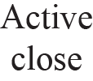
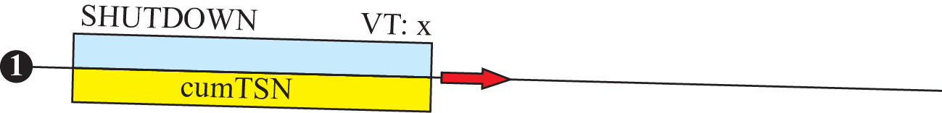
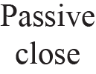
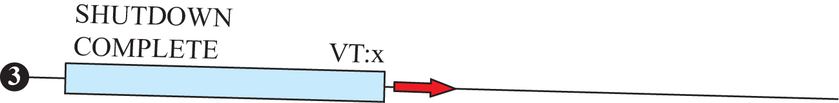
Figure 24.46 : Association termination

Slide 20
24.4.5 Flow Control
Flow control in SCTP is similar to that in TCP. In SCTP, we need to handle two units of data, the byte and the chunk. The values of rwnd and cwnd are expressed in bytes; the values of TSN and acknowledgments are expressed in chunks. To show the concept, we make some unrealistic assumptions. We assume that there is never congestion in the network and that the network is error free.

Slide 21
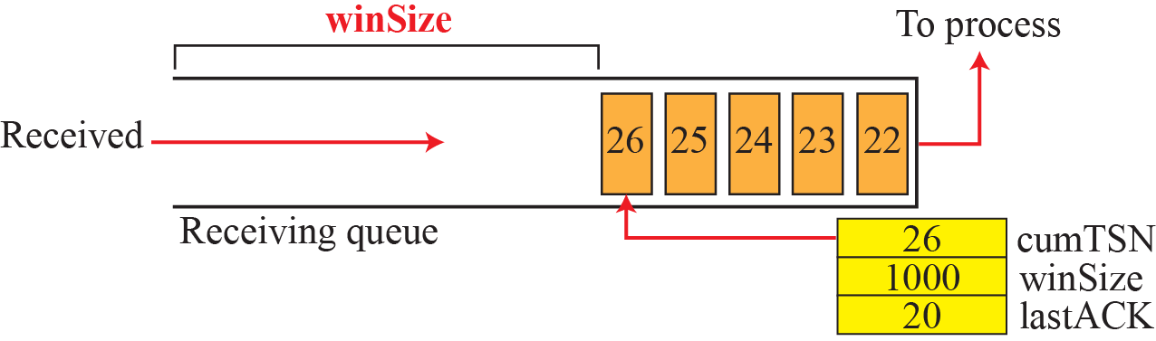
Figure 24.47: Flow control, receiver site

Slide 22
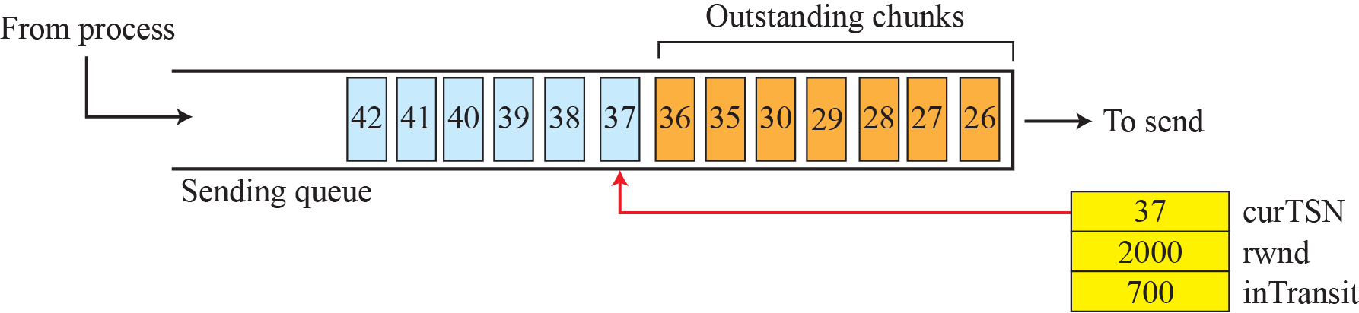
Figure 24.48: Flow control, sender site

Slide 23
24.4.6 Error Control
SCTP, like TCP, is a reliable transport-layer protocol. It uses a SACK chunk to report the state of the receiver buffer to the sender. Each implementation uses a different set of entities and timers for the receiver and sender sites. We use a very simple design to convey the concept to the reader.

Slide 24
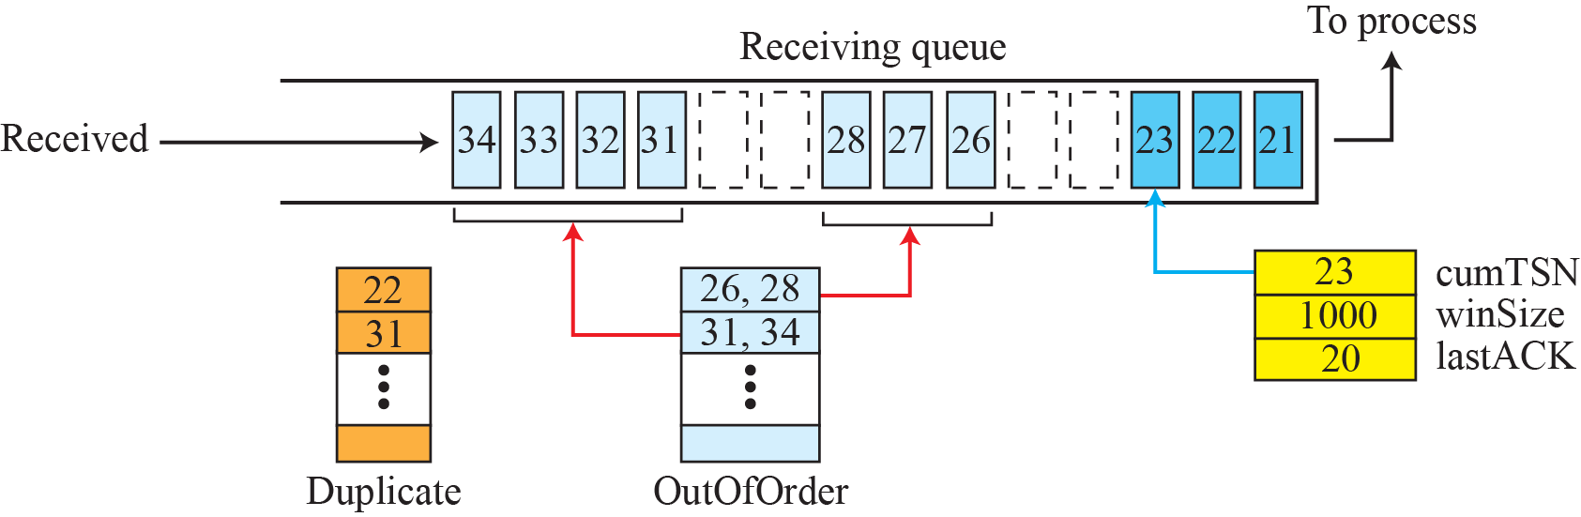
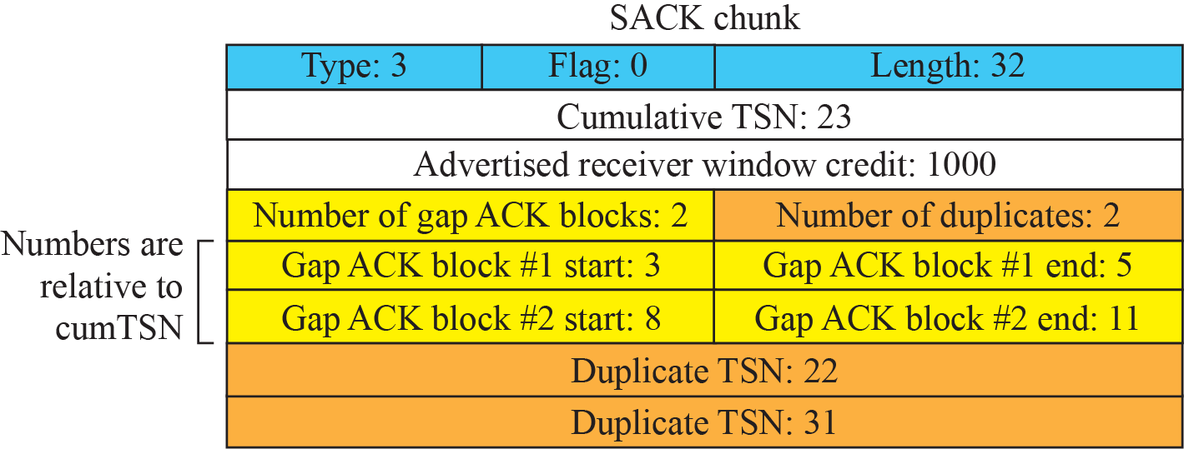
Figure 24.49 : Error control, receiver site

Slide 25
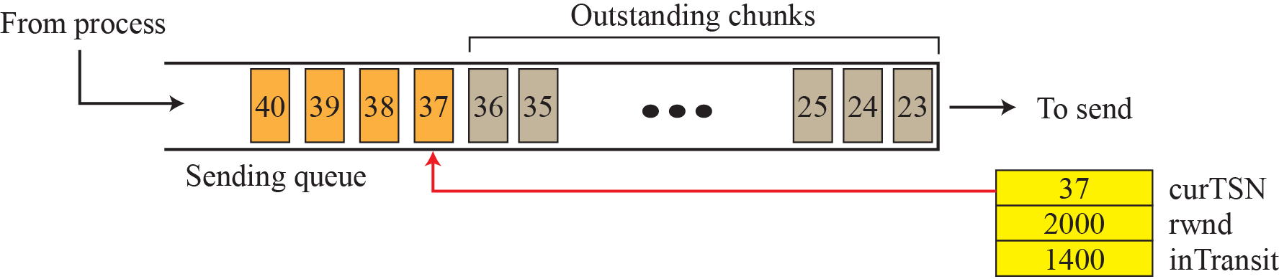
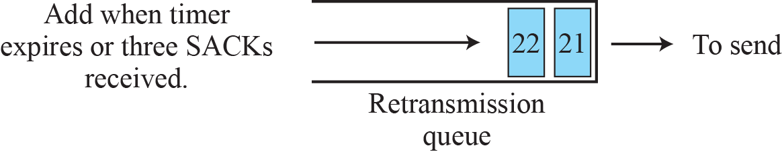
Figure 24.50 : Error control, sender site

Slide 26
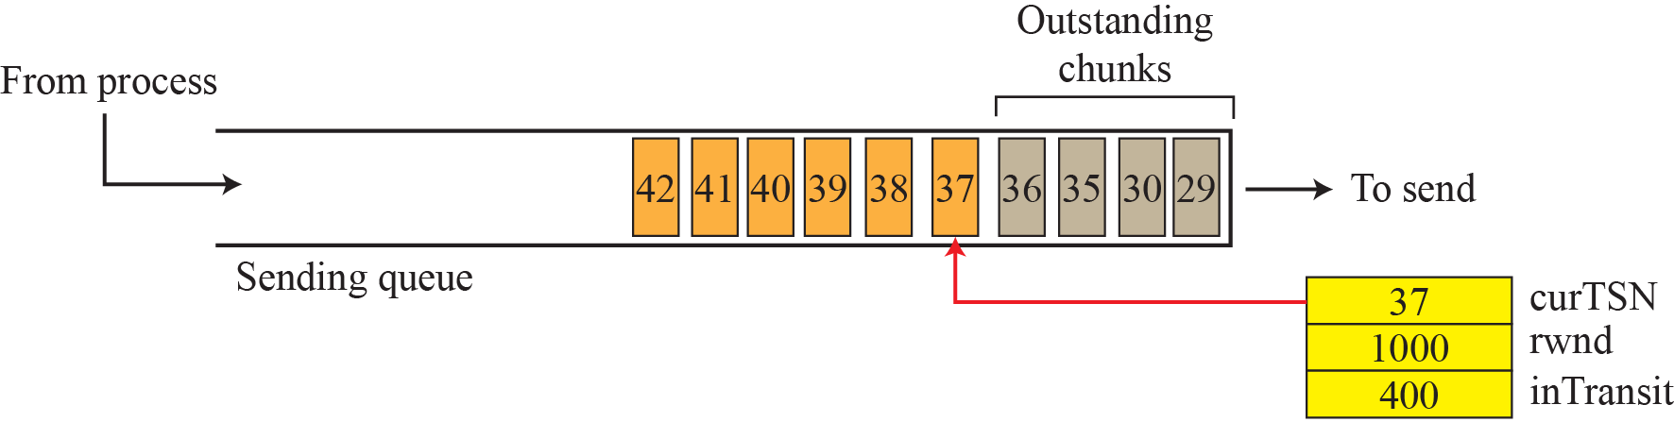
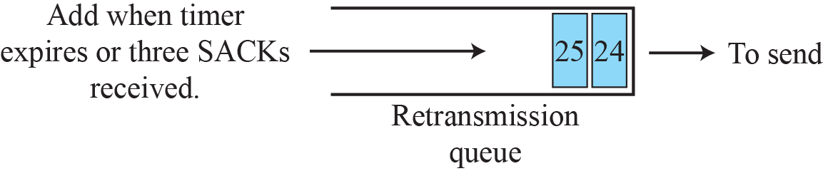
Figure 24.51: New state at the sender site after receiving a SACK chunk

Slide 27
Check Your Understanding
What is the difference between Go back N and Selective Repeat Protocol?

Slide 28
Outcome
Student should be able to understand
Transport Layer Flow control protocols
Simple protocol
Stop and wait protocol
Go back N protocol
Selective Repeat protocol

Slide 29
THANK YOU

